Slide 1
Prog-02C Documentation
Micah Lyle
Cs 160 Spring 2016
https://github.com/cs160-sp16/prog-02-represent-MicahLyle
https://youtu.be/3noXffw7RDw

Slide 2
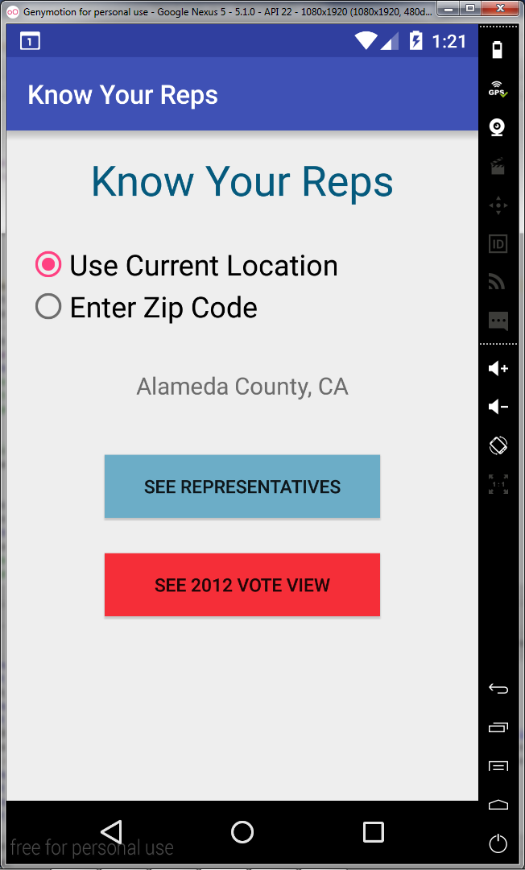

Main view phone
Choose Current Location or Zip Code

Slide 3
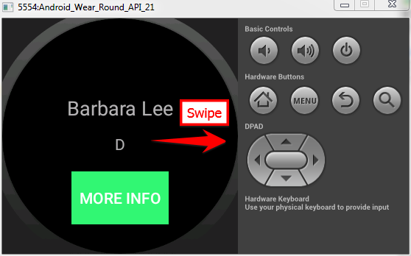
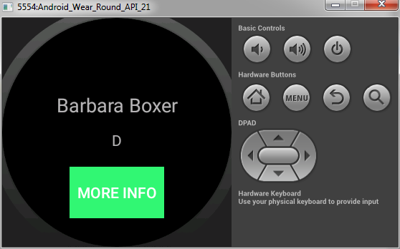

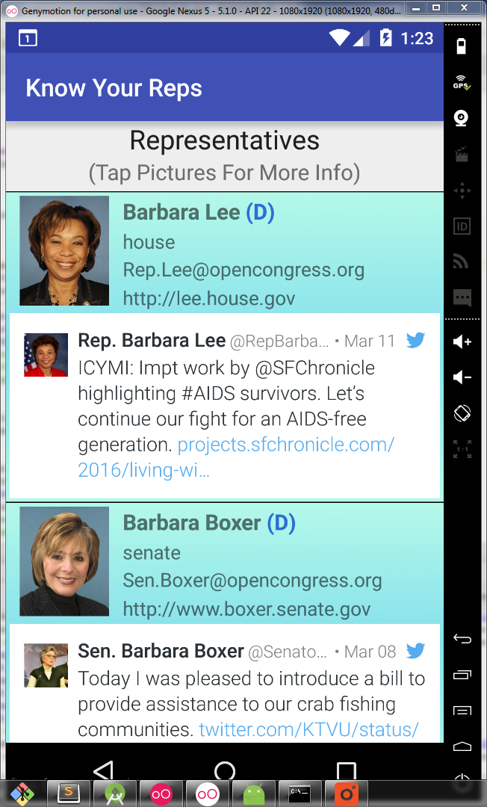
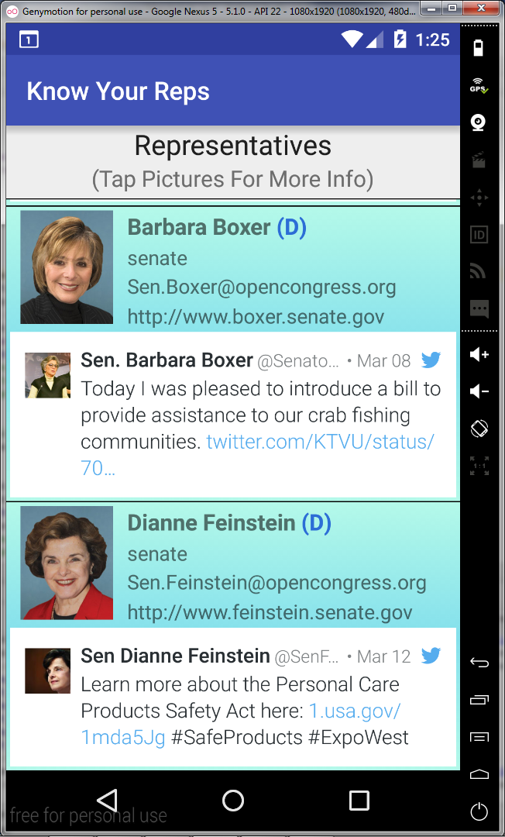
Representatives view
This View on Phone Automatically opens the view on the watch
Clicking on More Info Opens Phone Detailed View
Scroll down
Clicking on Representative Image Opens Phone Detailed View
To detailed view

Slide 4
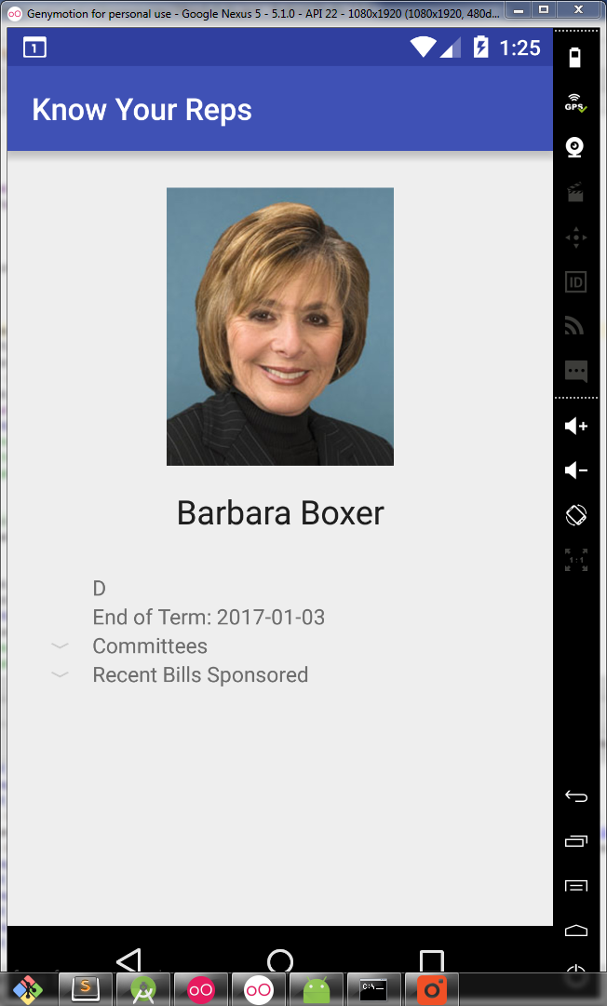
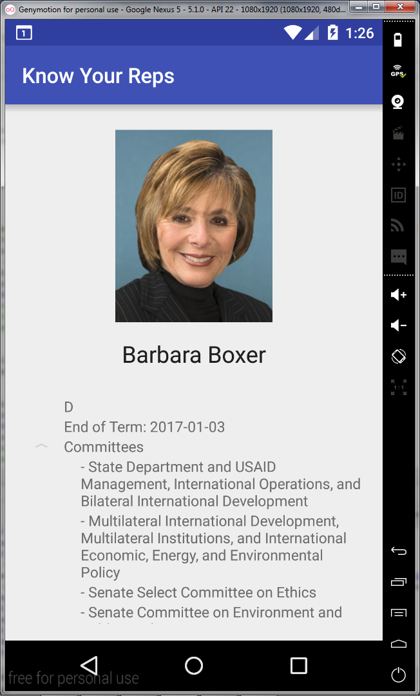

Detailed view phone
Expand Committees
Expand Bills

Slide 5
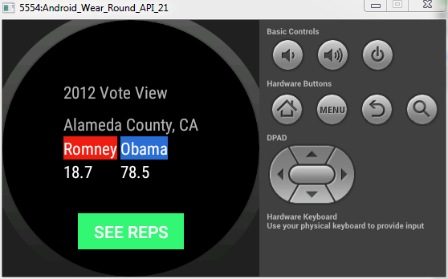

Watch vote view
Current Location Selected and Vote View Button Pressed
Zip Code Entered (10001 in this case)

Slide 6
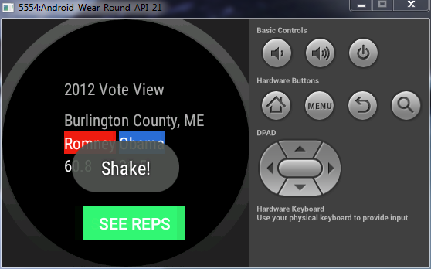
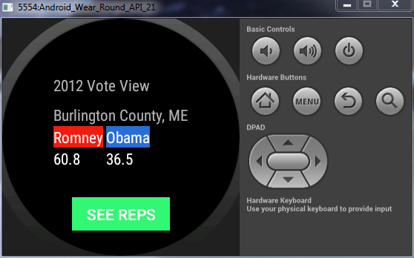
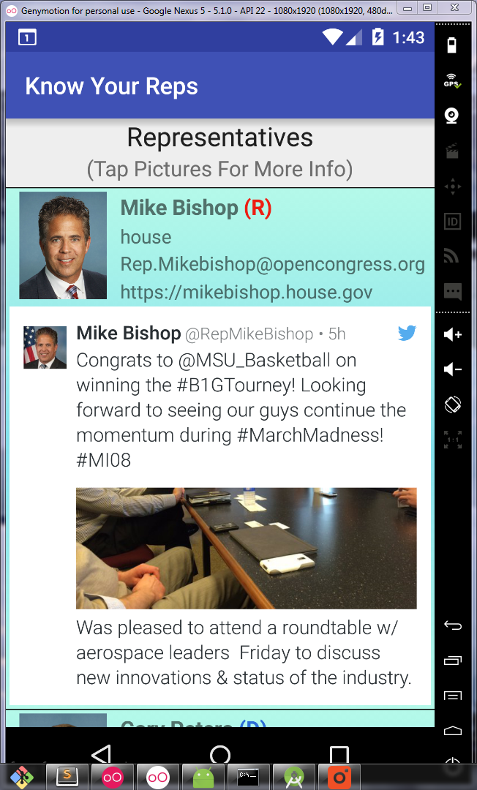
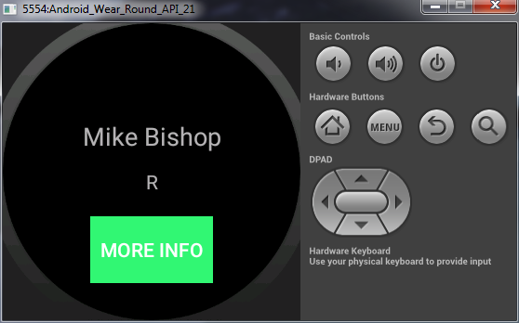
Watch shake and vote view phone update
Shaking watch selects a random location in
the USA and updates information accordingly
Pressing “See Reps” Updates the Phone Representatives View to this County

